Slide 1
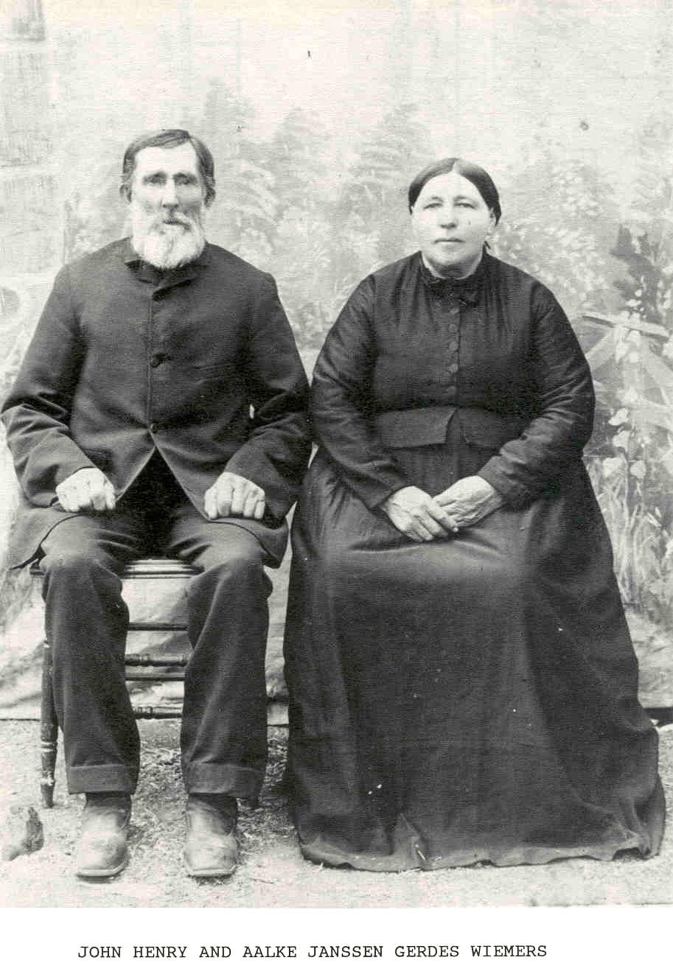

Our Ancestors & the German Language in Medina County
By
Elaine Wiemers Coyle

Slide 2
Dear Viewer,
I began the slideshow speaking German, explaining how I am related to the Wiemers Family. I later explained in English that Sherri Grell (this year’s chairperson) asked me to present at the Wiemers Reunion and teach everyone a little bit of German. Sadly, I am not a fluent German speaker, but I do speak it as much as I can.
My father, Meryle Wiemers, went to school speaking only German. He learned from his parents, who learned from their parents. Pictures on the 4th slide show my relationship, being the 5th generation. I am in the picture on the lower bottom, second from the left. Quihi Bethlehem Lutheran Church has formed an Edelweiss Verein aus Quihi (German Club) that I teach. We eat German food and visit (in German as much as we can) after church about once a month. Anyone is welcome.
Purposes for this slideshow are listed on the next two slides.
Elaine (Wiemers) Coyle

Slide 3
The purposes of this slide show are as follows:
To learn about our ancestors’ language that was brought to America when they immigrated in 1851.
  Johann Wiemers and Aalke Gerdes families immigrated speaking Plattdeutsch (Low German).
  Their language changed and created new dialects in order to communicate with the people around Medina County, i.e., Alsatian, Hochdeutsch, Plattdeutsch, and English. (Map showed where different dialects are in Germany.)
  Show timeline of Medina County (1845-1877).
  Explain TTU Professor Dr. Maike Rocker’s visit to Quihi and interviews.
  Understanding the difference between Germanic and Romantic Languages. Many English and German words sound familiar because both languages are Germanic.
  There was no unified language in 1850 in Germany, however Hochdeutsch (High German) was the primary written German language. In 1901 (50 years after they arrived in TX) Germany officially made Hochdeutsch the unified language, but many Germans spoke dialects in all areas until around 1950.
To show where the Wiemers settled in Medina County, viewing several maps.

Slide 4
Hardships from the Aalke Gerdes family enroute to Germany, including two of her younger brothers being buried at sea and her mother passing 2 years after arrival in Texas.
Reasons to learn a little German.
  Our ancestors spoke it.
  Read some historical documents (baptism, tombstones, church records).
  Fun and Travel
Speak some simple German words and phrases, using common German pronunciations.
Recite an early 1900 German meal prayer and a German playground rhyme that Meryle (my father) spoke many times.
Learning that all Nouns are capitalized within a sentence.
Participate in a little Trivia Questionnaire for fun.
Enjoy!
Elaine

Slide 5
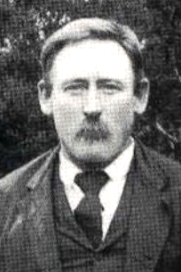
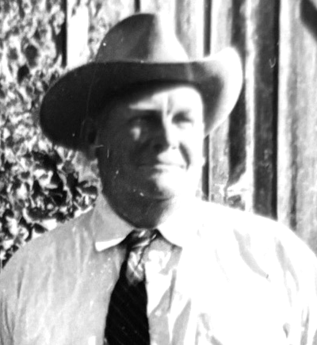
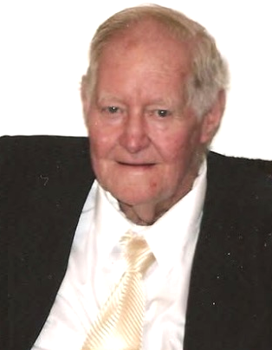
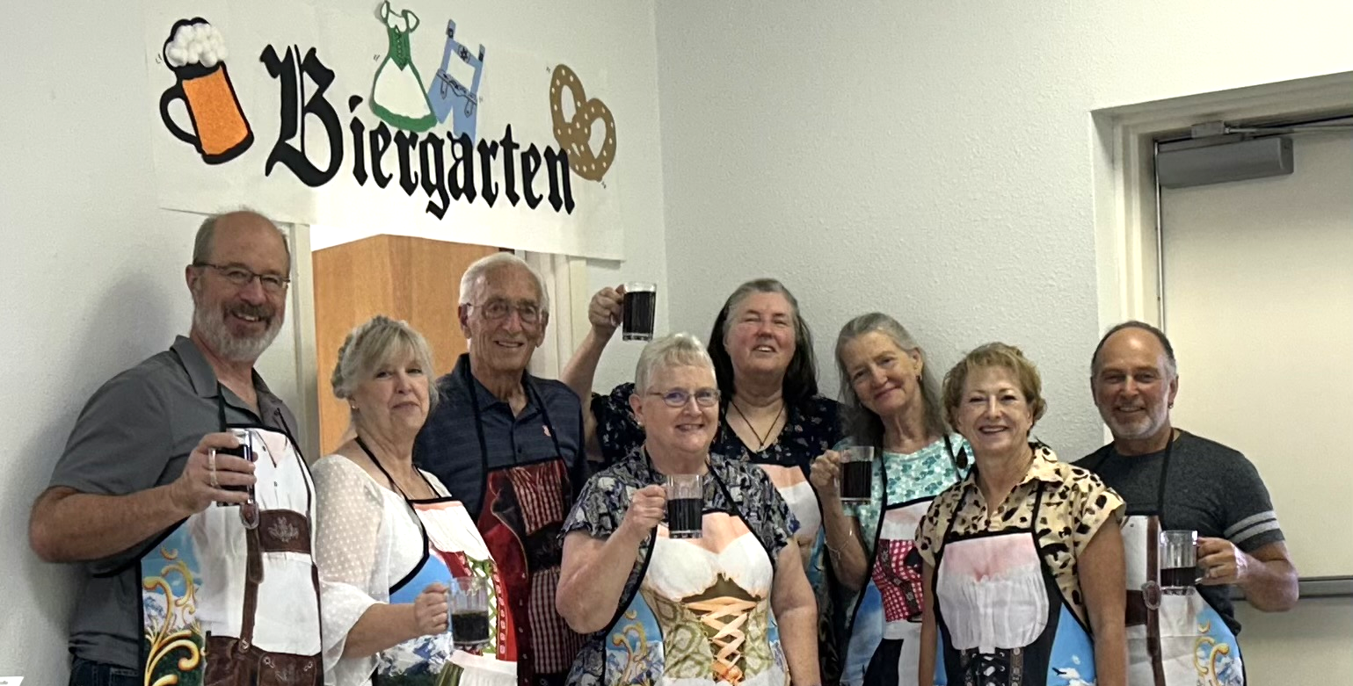
Groß-Urgroßvater= Great-great-grandfather
Johann Hinrich Wiemers
Groß-Urgroßmutter= Great-great-grandmother
Aalke Janssen (Gerdes) Wiemers
Urgroßvater= Great-grandfather
Bernhardt Christian Wiemers
Großvater= Grandfather
Otto Wiemers
Vater = Father
Meryle Wiemers
What German dialect did our
ancestors speak?
Edelweiss Verein aus Quihi
How can we use German?
Let’s speak some German!

Slide 6
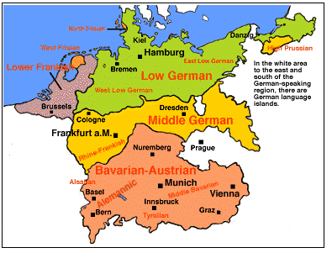
Where did people in Medina County emigrate from?
Aurich, Ostfriesland=Plattdeutsch (Low)
Württemberg=Hochdeutsch (High)
Alsace-Lorraine=Alsatian

Slide 7
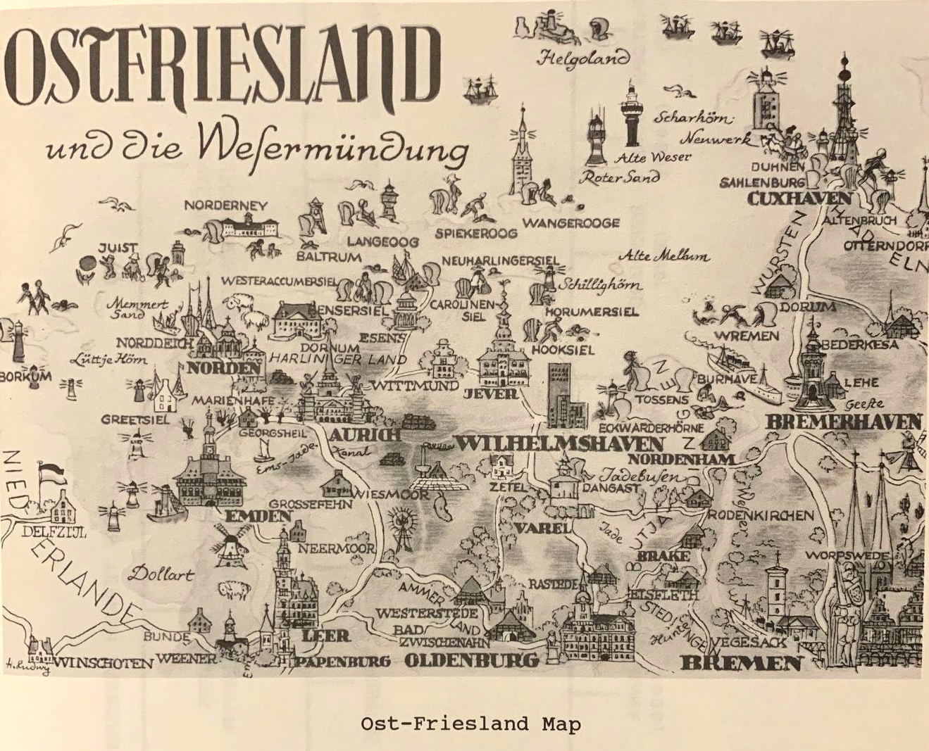
Where did the Wiemers Family come from?
Aurich, Ostfriesland

Slide 8
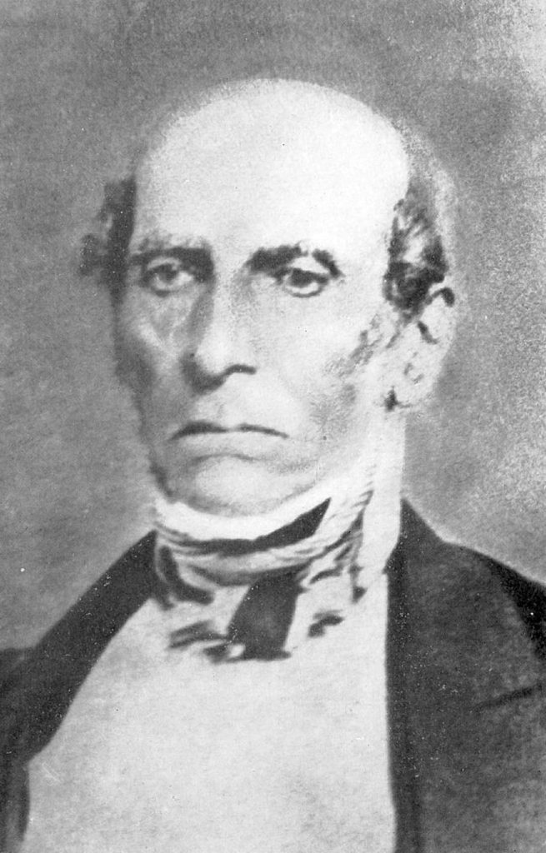
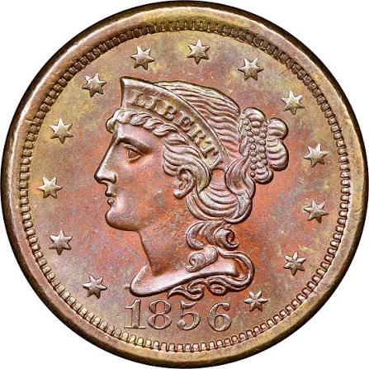
Let’s remember….
1845-1847–Henri Castro settles Castroville, Quihi, Vandenburg, which moved to
New Fountain after the Verde Creek (Lucky’s) went dry, and D’Hanis
1851–Johann & Christoff Wiemers arrived in TX on December 20, 1851.
1855–Aalke Gerdes arrived in TX with parents, Jan & Venne Gerdes
1856–Johann & Aalke married
1858–Wiemers Oak Services (Ebenezer Methodist Church)
1860–1865–Civil War
1877–Last Indian Raid in Medina County
Henri Castro
Where did they decide to live?
Johann Wiemers & Friederick Muennink pooled their money and resources together. They purchased overlapping land tracts from previous Castro Colony grant holders along Verde Creek to carve out the
1,000-acre New Fountain settlement.

Slide 9
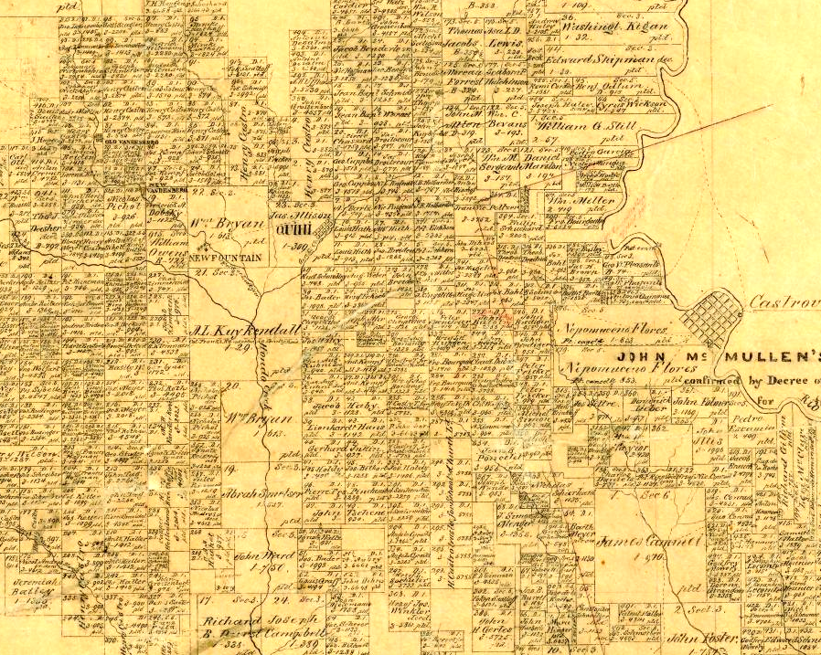
Medina County
1862
Vandenburg
Quihi
New Fountain
Jan (John) Gerdes=
father of Aalke

Slide 10
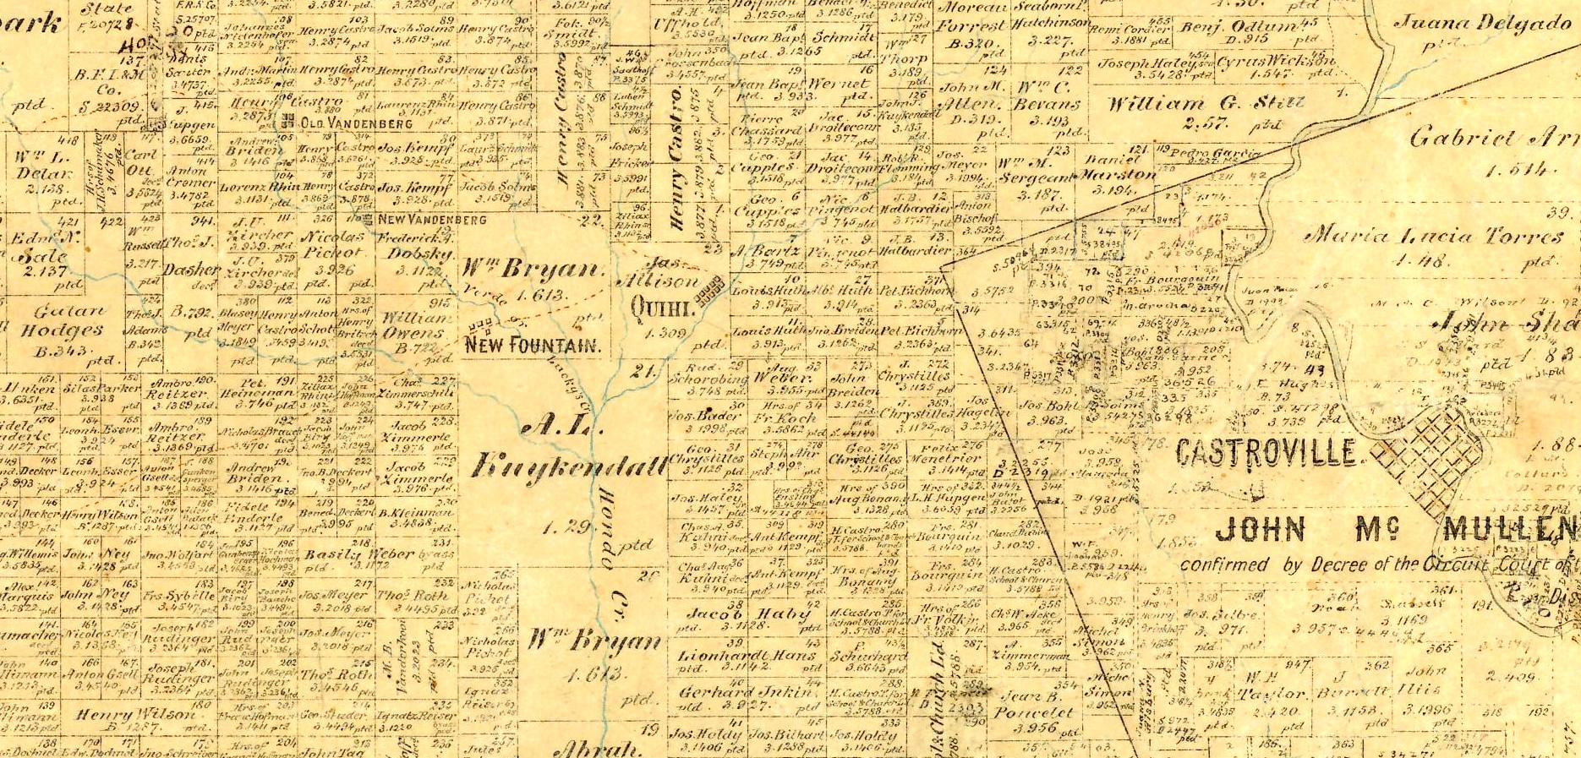
Medina County 1880
Wiemers home in New Fountain

Slide 11
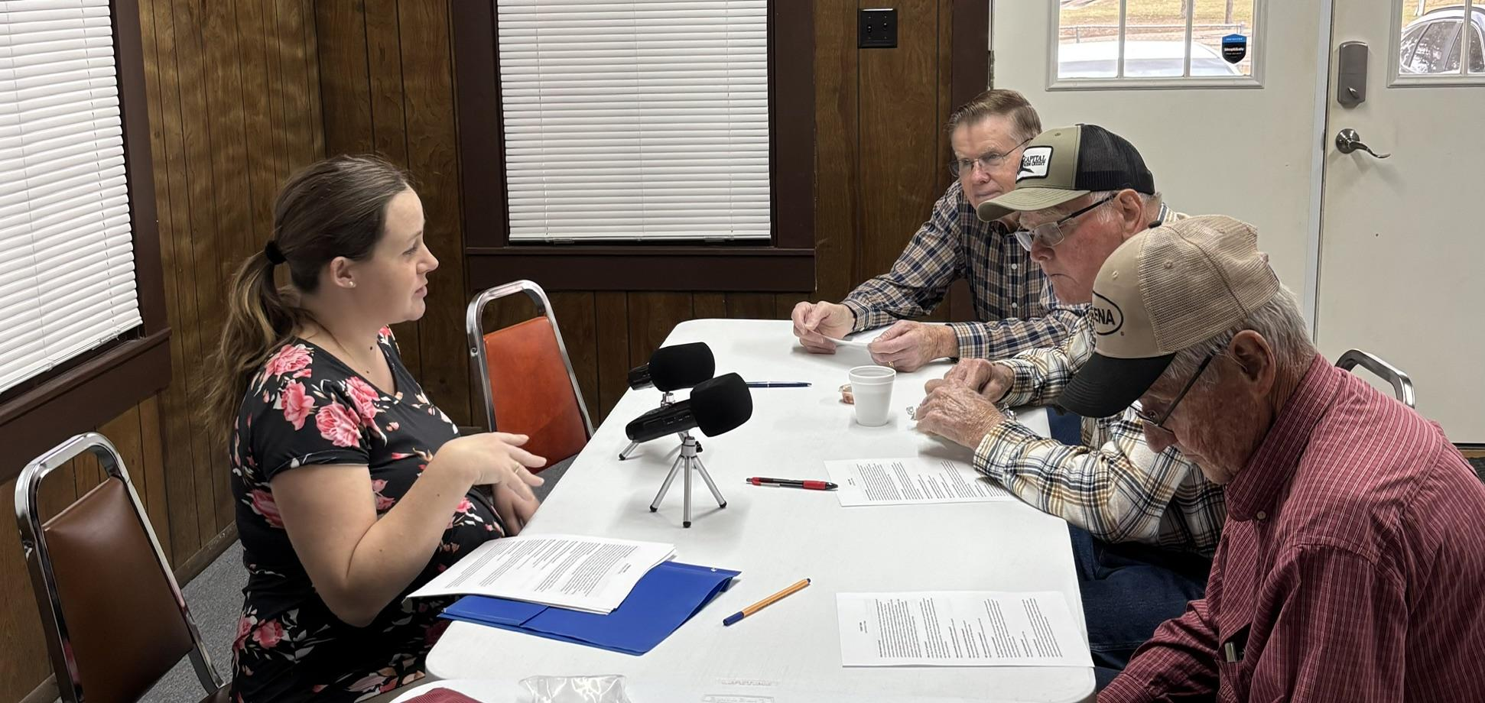
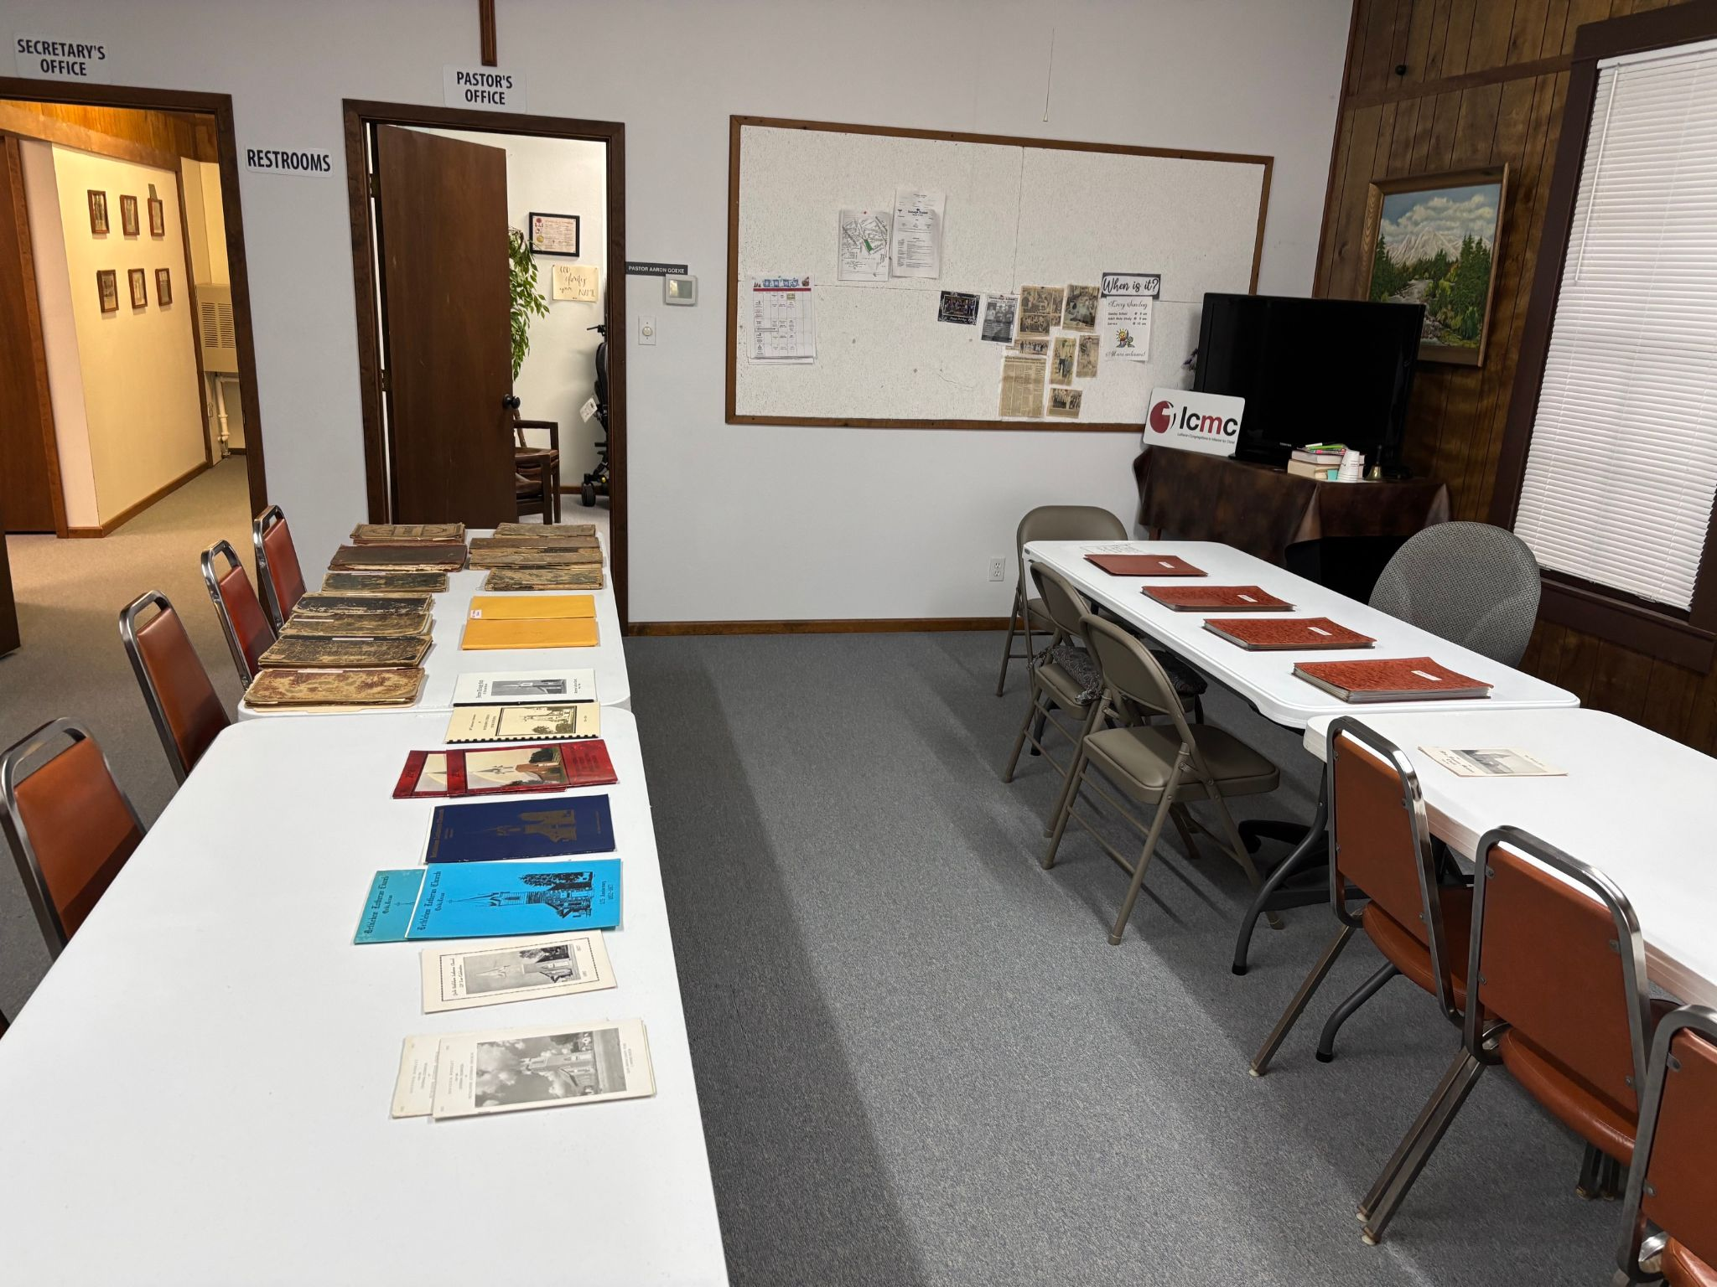
Texas Tech University German linguistic professor Dr. Maike Rocker (originally from Aurich) came to Quihi in January 2026 to interview native German speakers and analyze Quihi & New Fountain church records.
Spoken language was not low German –combination of dialects (Low, high, Alsatian, & TX English)
Leonard & Richard Saathoff
& Cordell Bohlen
Both church records were in high German.
Results take 5 years to be published.
She wants to return because no one had researched this area.

Slide 12
What did our ancestors speak?
Why does German sound a bit like English?
Combination of these languages:
Low German/Dutch
High German
Alsatian
English (Texas)
Germanic Languages
English
German
Dutch
Yiddish
Swedish
Danish
Norwegian
Bulgarian
Romantic Languages
French
Spanish
Italian
Portuguese
Romanian

Slide 13
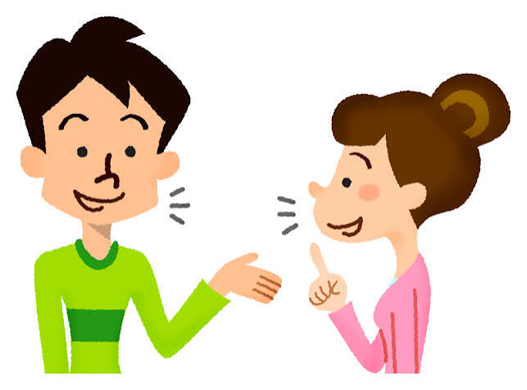

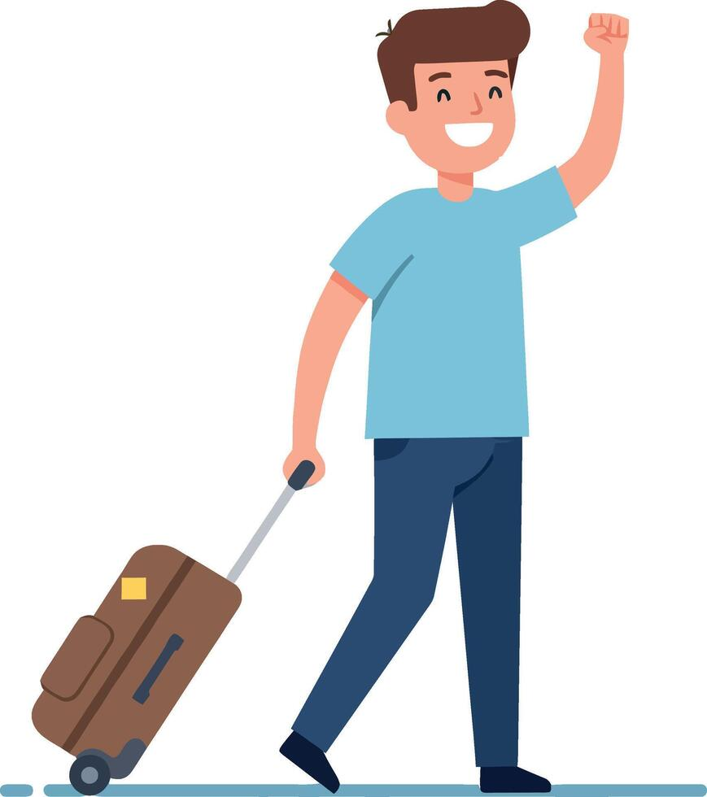
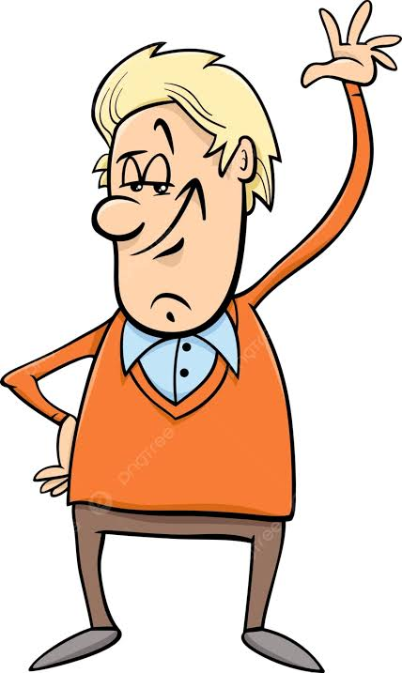
Why do we want to learn some German?
Our ancestors spoke it!
To research documents
To travel
For fun!

Slide 14
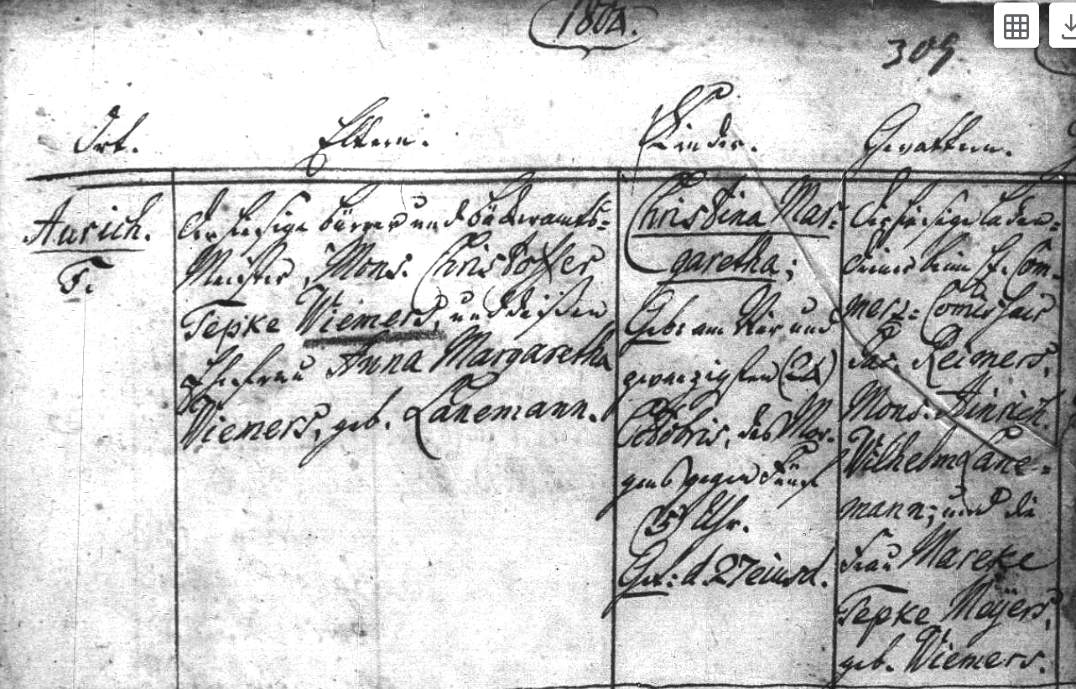
kinder =
children
Gotteltern =God-
parents
1804 Baptism (Taufe) Record in Aurich, Ostfriesland.
Rufname is Wiemers:
Christoffer Tepke Wiemers
(father of Johann Wiemers)

Slide 15
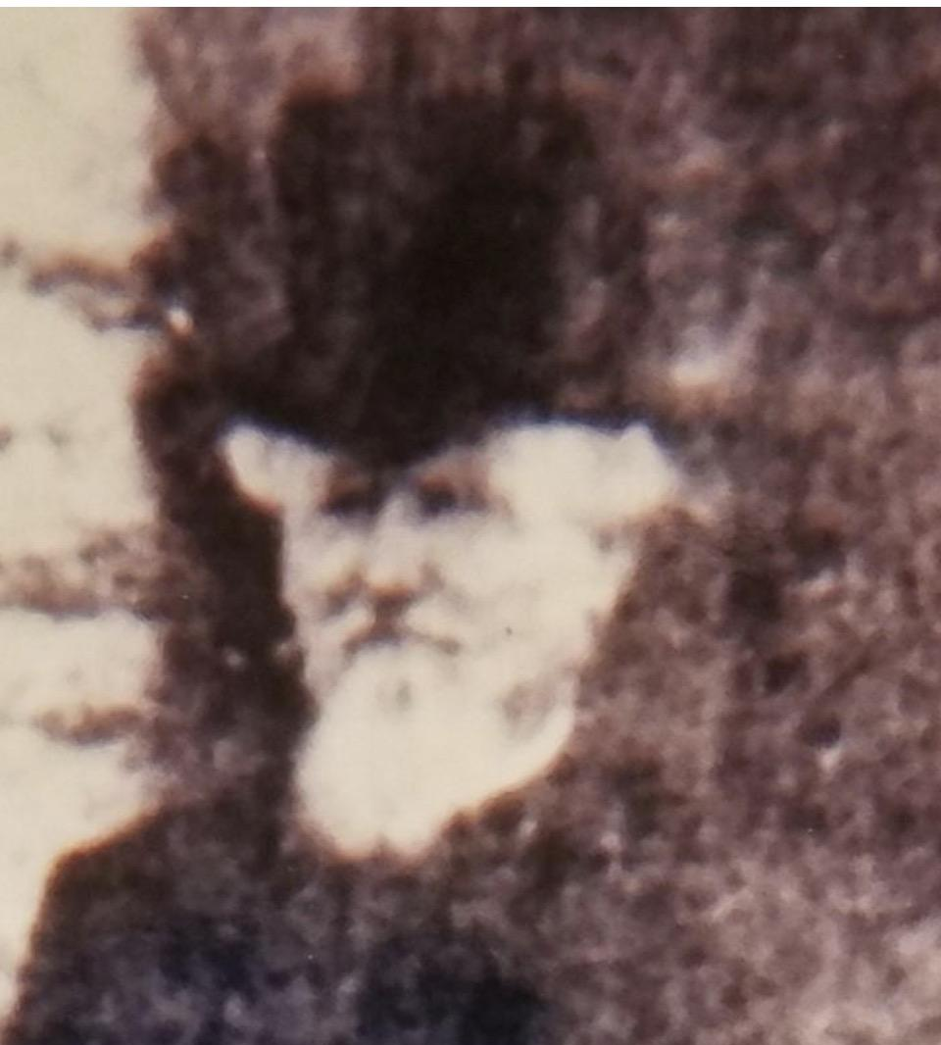
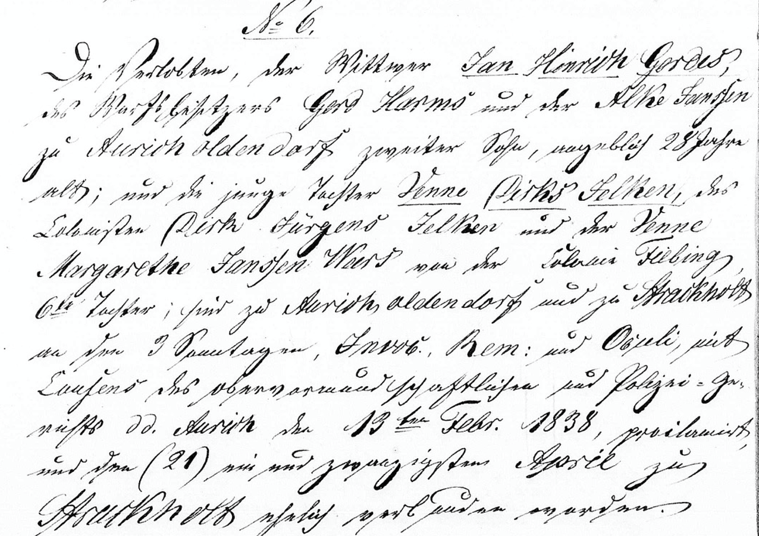
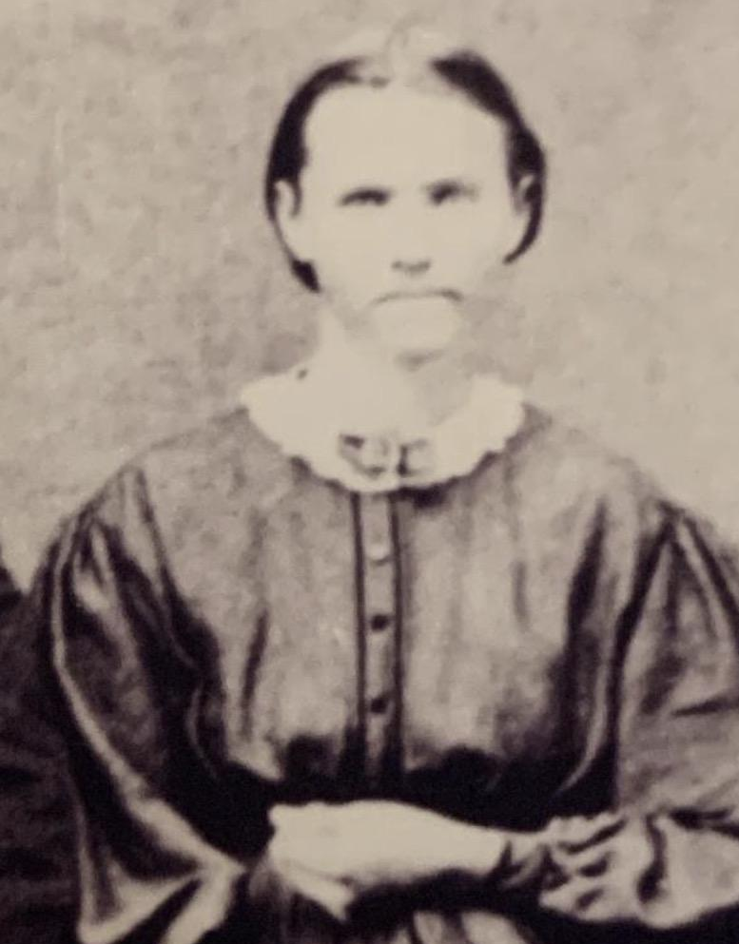
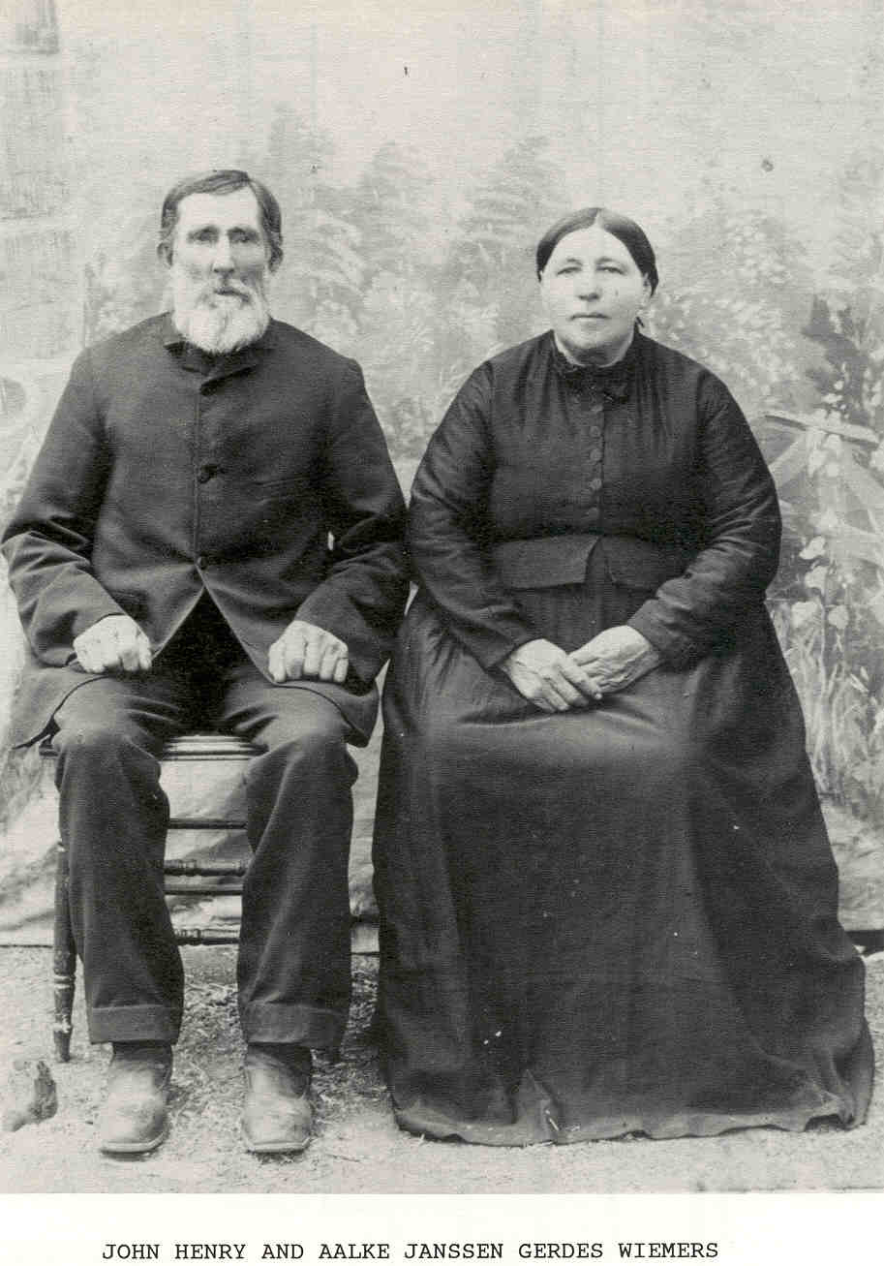

Marriage of Jan Hinrich Gerdes & Venne Dirks Telken
(parents of Aalke)
Jan Hinrichs Gerdes
1809-1889
Almte Janchen* (Alma Johanna) Gerdes
8/15/1832-1922
M. 1831
Almt Jansen Rademacher
1804-8/15/1832
Aalke Jansen Gerdes
1839-1923
M. 4/21/1838
7 more boys (born Germany)
Dietrich Dirk Gerdes
(1841-1918)
Gerhardt (Gerd) Janssen
Gerdes (1844-1913)
Jürgen Janshen Gerdes
2 wks-(1847-1847)
Jürgen Janshen Gerdes
4 yrs-(1849-1853*)
Harberth Gerdes
5 yrs-(1850-1855*)
Dietrich Gerdes
3 yrs-(1852-1855*)
Jürgen Eilers Janssen
Gerdes (4/1855-1915)
Venne Margarethe Dirks Telken
1813-1857
Arrived
in TX
in 1855

Slide 16
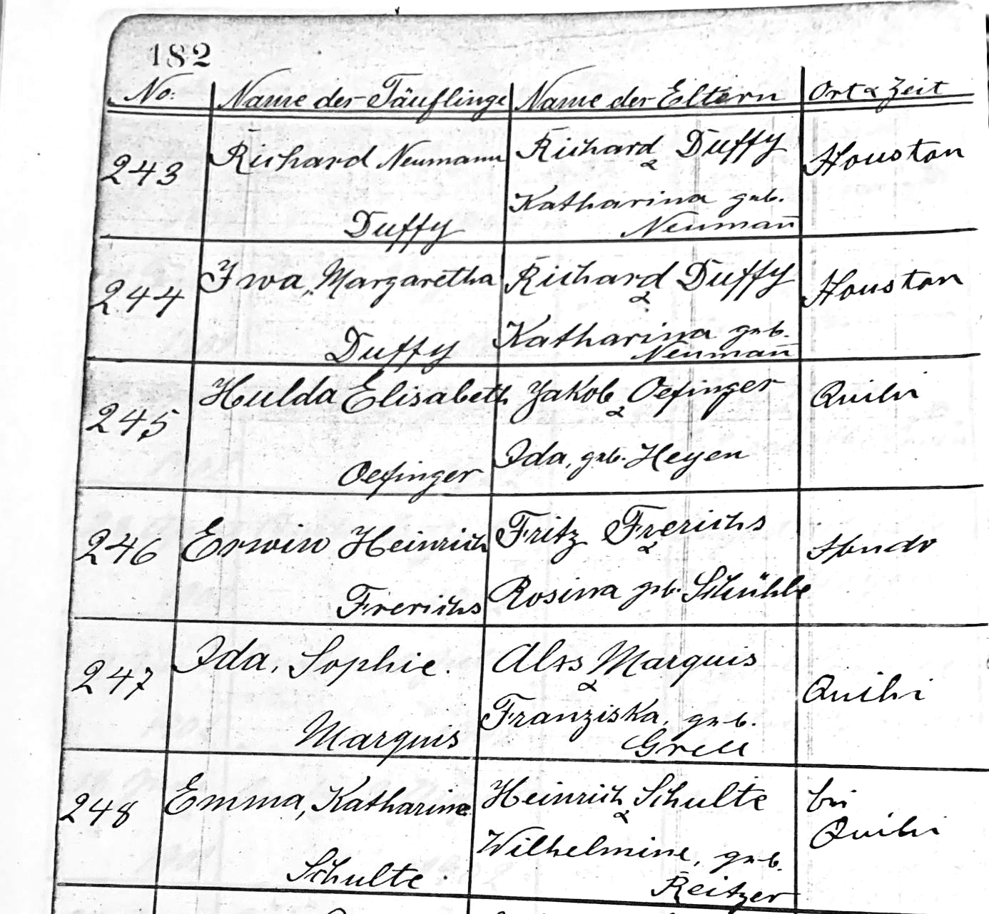
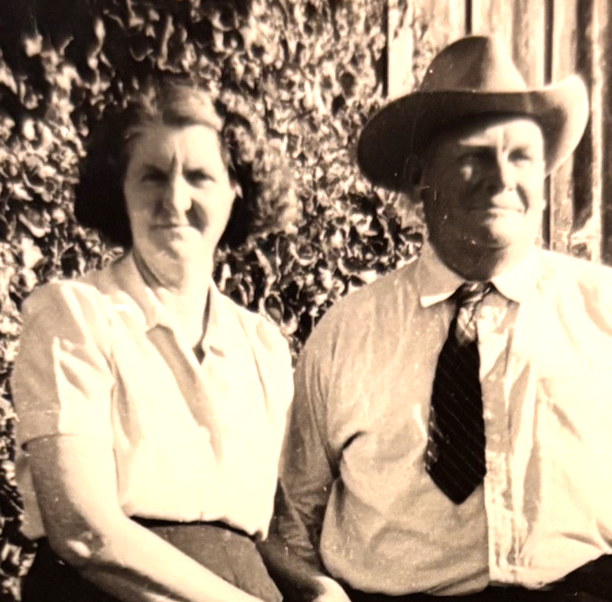
Name of the little baptized child
Baptism
Record
from
Quihi Bethlehem Lutheran Church
Name of Parents
Place & Time
(time omitted)
**************
“Bei Quihi”=
by Quihi (Dunlay)
Parents
“Heinrich Schulte &
Wilhelmine, geb. Reitzer”

Slide 17
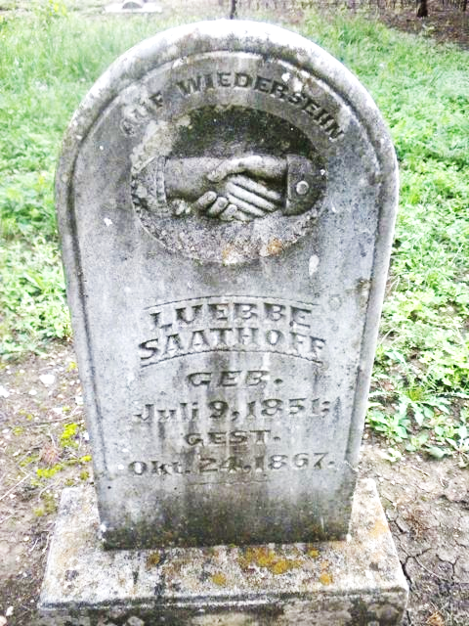
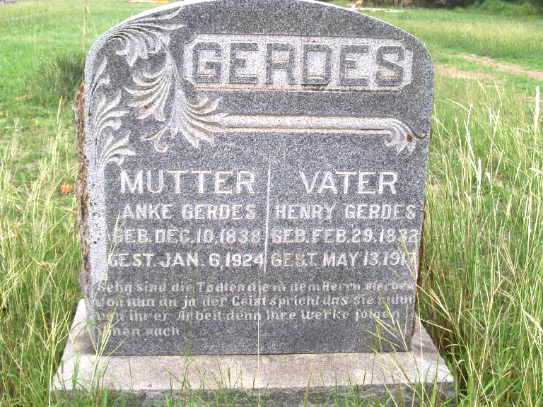
Geb=geboren (born)
Gest=gestorben (died)
Juli=Juli
(July) Okt=Oktober
(October)
May=May
(English)
Mai=May
(German)

Slide 18

W is /v/ Wurst (sausage)
V is /f/ Vater (father)
F is /f/ Fest (festival)
Z is /ts/ Zimmer (room)
ie is long /e/ Wiemers
ei is long /i/ mein (my)
Umlauts: ä ö ü
ä = ae long /a/ Mädchen (little girl)
ö = oe /oo/ in soon schön (pretty)
ü = ue long /u/ grün (green)
ß = ss /s/ Weiß (white)

Slide 19

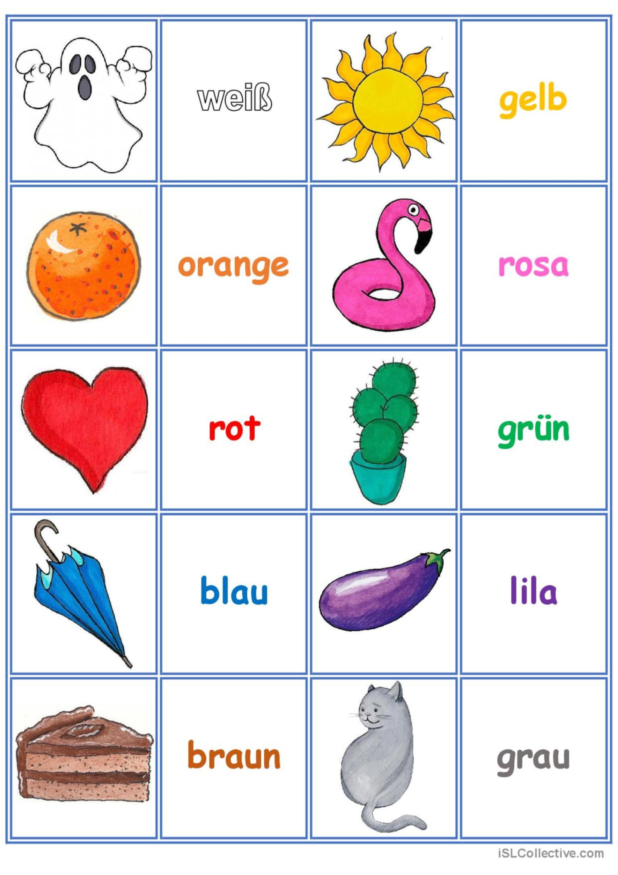
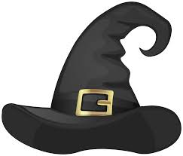
schwartz
purpur

Slide 20

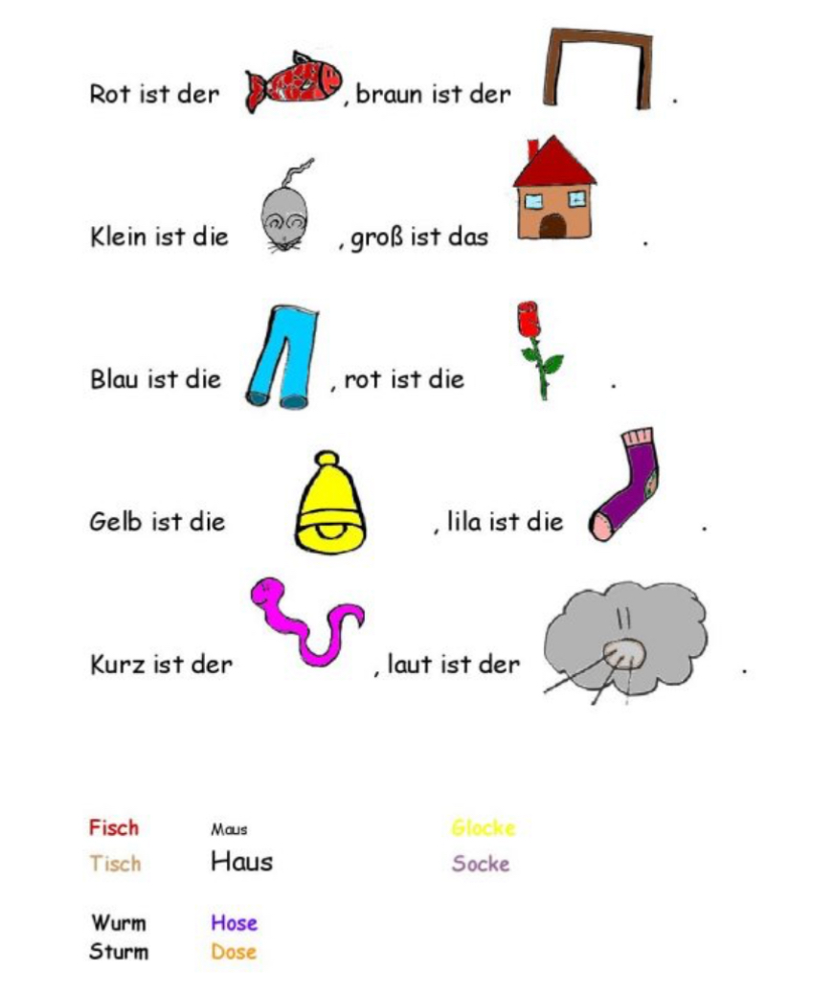
Maus Haus
Fisch Tisch
Hose Rose

Slide 21
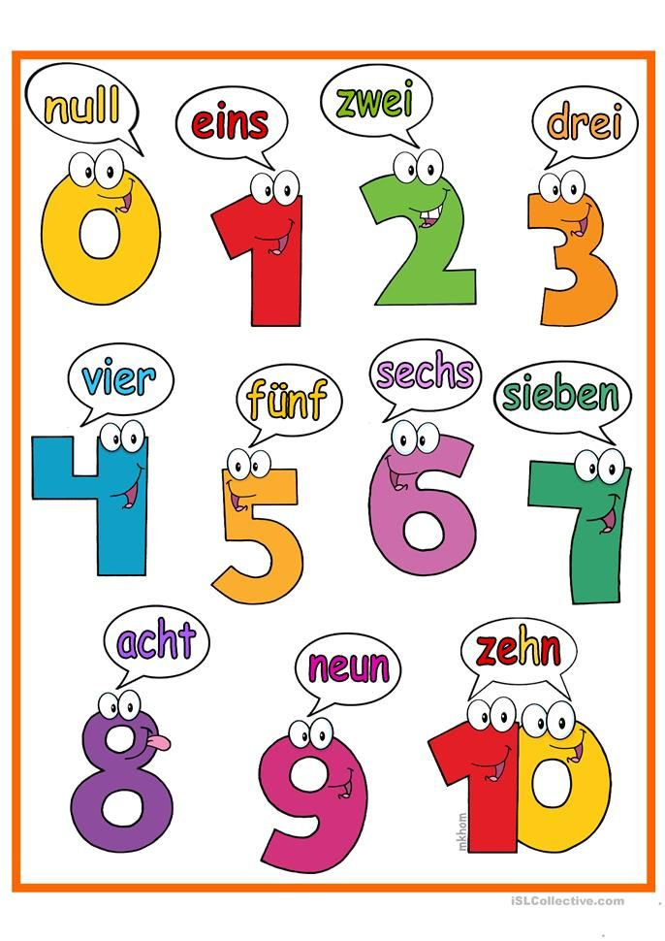

Slide 22
Hello
Hallo
Good-bye
Auf Wiedersehen
Tschüss
I don’t know.
Ich weiß nicht.
How are you?
Yes or No?
ja oder nein?
Wie geht’s?
It is going well for me.
Es geht mir gut.
Left and Right
links und rechts
Good night!
Gute Nacht!
Welcome!
Willkommen!
Thank you!
Danke!
Do you speak English?
You’re welcome!
Bitte!
Sprechen Sie Englisch?
Macht nichts.
*
Doesn’t matter.
Mein Deutsch ist nicht so gut.

Slide 23



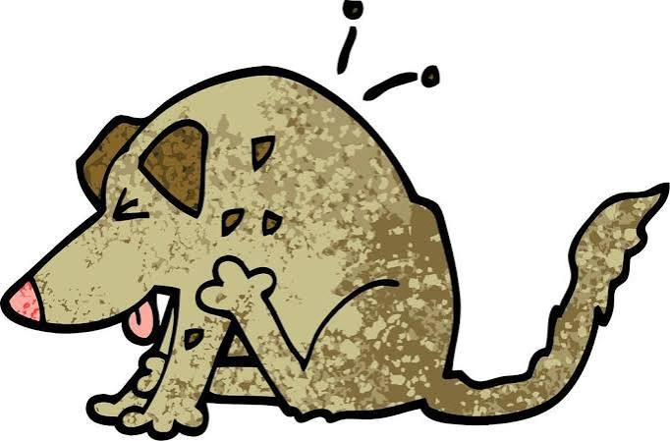
Nouns-capital
Pronouns-lowercase
I=ich
you=du
we=wir
he/she/it=er/sie/es
Abba liebe Vater, Amen.
A B C Katz im Schnee,
Hund hinterher
mit der Arsch voller Flöh!
A B C die Katze lief im Schnee, der Hund kam hinterher
mit der Tasche voller Flöh!

Slide 24



Slide 25
What year did Johann come to America?
Johann in 1851
Aalka in 1855

Slide 26
2. What do the words geboren and gestorben mean in English?
born
died

Slide 27
3. What was Aalke’s maiden name?
Gerdes

Slide 28
4. How old would Johann Hinrich Wiemers
be in 2026?
200 years old
März 20, 1826

Slide 29
5. How do you ask, “How are you?” in German?
Wie geht’s?

Slide 30
6. What is hose in English?
pants

Slide 31
7. What places were founded first by Henri Casto?
Castroville (1844)
Quihi (1845)
Vandenburg (1845)*
D’Hanis (1847)
*New Fountain (1847) left Verde (Lucky’s) Creek dried up and left Vandenburg.

Slide 32
8. What year was the last Indian raid in Medina County?
1877
(26 years after Wiemers arrived in TX.)

Slide 33
9. What town did the Wiemers immigrate from?
Aurich, Ostfriesland

Slide 34
10. How do you say the months October and July in German?
Oktober
Juli

Slide 35
11. How do you say yes and no in German?
ja
nein

Slide 36
12. What do the words Hund and Katze mean in English?
dog
cat

Slide 37
13. How do you say white in German?
weiß

Slide 38
14. Did John & Aalke marry in Germany or Texas?
Texas 1856
(5 years later)

Slide 39
15. What German dialect did people from Ostfriesland speak?
Plattdeutsch (Low German)

Slide 40
16. How do you say the number 5 in German?
fünf

Slide 41
17. What words are capitalized in German?
nouns

Slide 42
18. What language group does German and English belong to?
Germanic Language

Slide 43
19. What year was the New Fountain Methodist Church established by meeting under John & Aalke’s oak tree?
1858

Slide 44
20. Tell me two ways to say “Goodbye” in German?
Auf Wiedersehen
Tschüss

Slide 45
DankeschÖn!
And don’t forget to pick up the German handouts!

